Slide 1
NCVI INVOLVING OUV (MID33853) AT CHUA CHU KANG CAMP ON 17 MAR 23 AT ABOUT 0940H

Slide 2
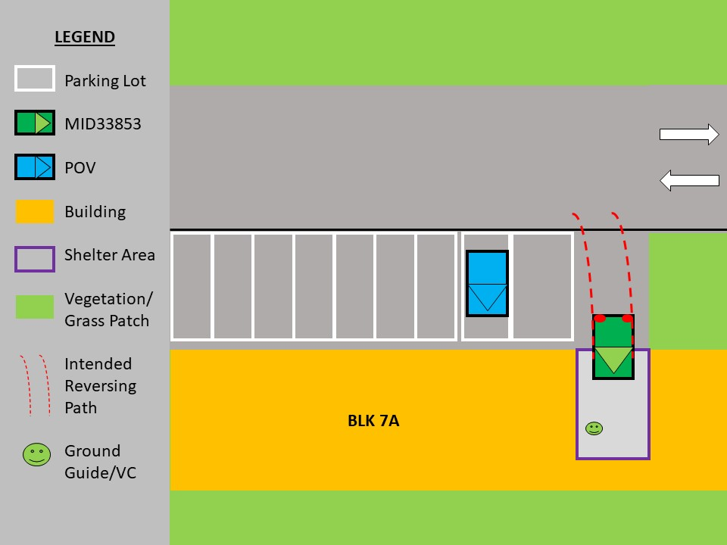
Schematic Diagram

Slide 3
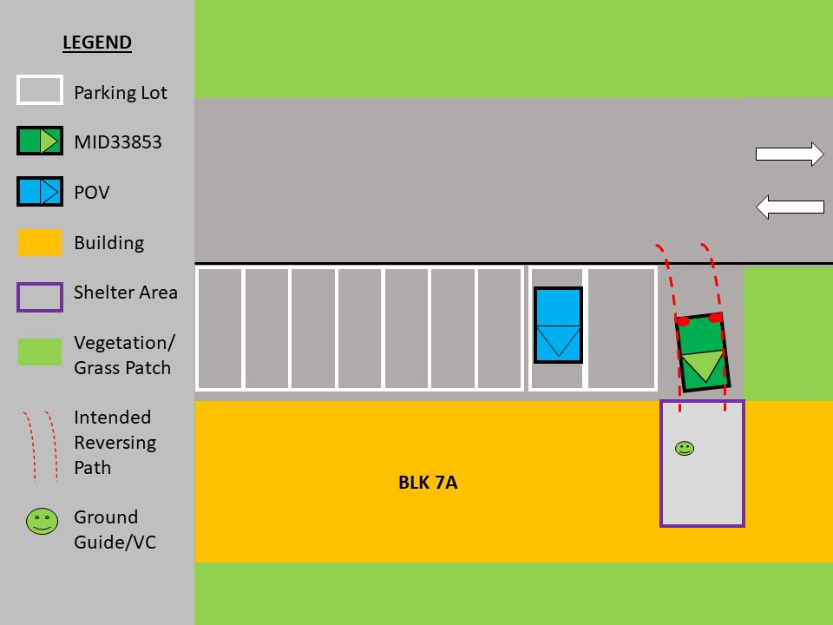
Schematic Diagram

Slide 4
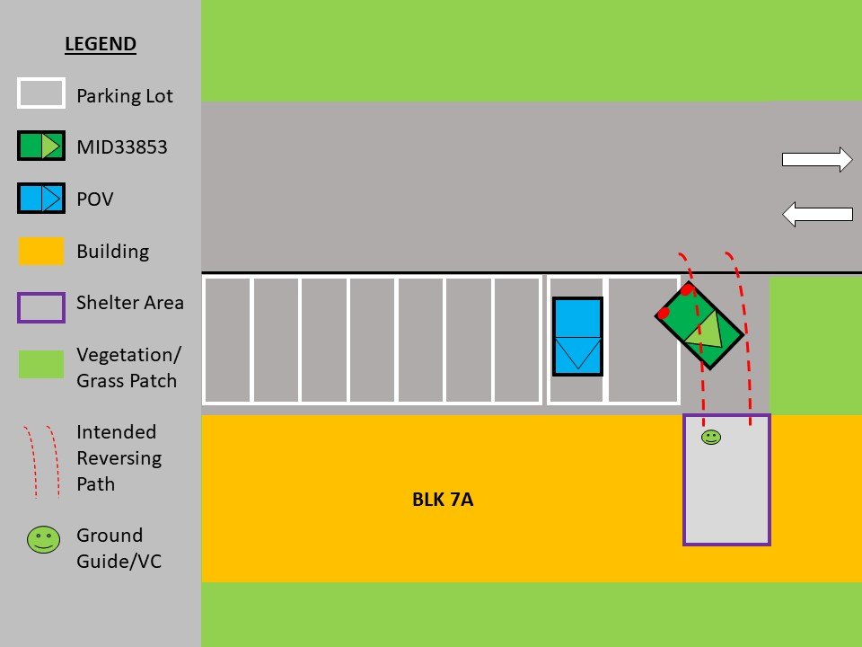
Schematic Diagram

Slide 5
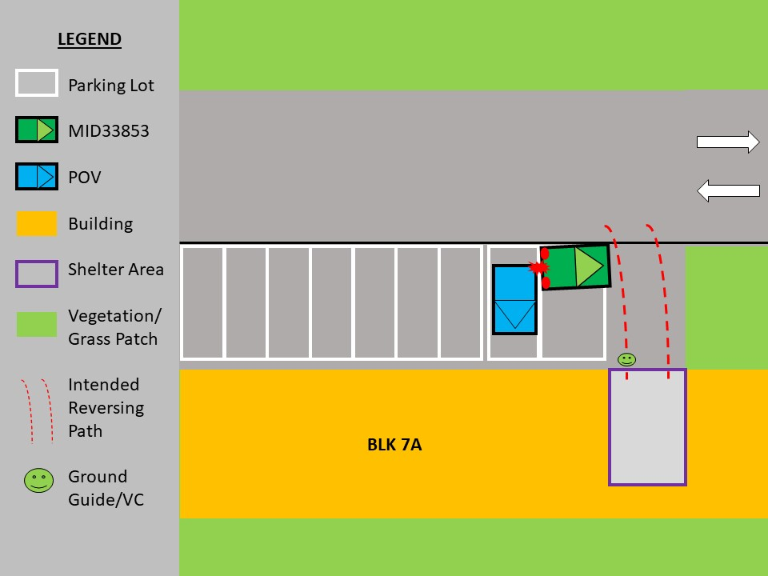
Schematic Diagram

Slide 6
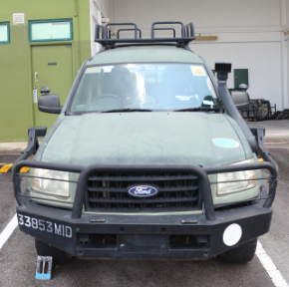
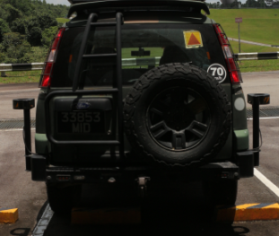
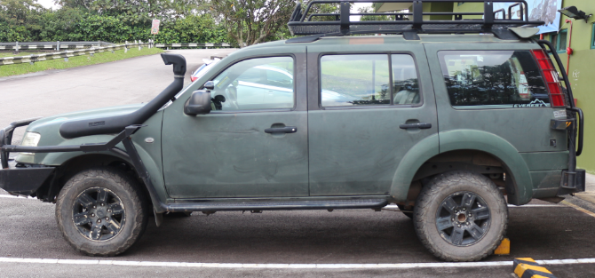
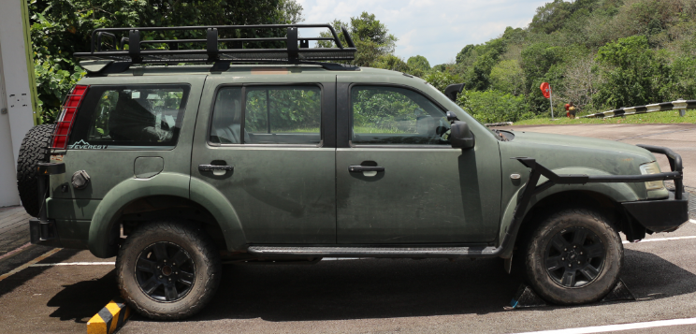
Photographs of MID33853
1
2
Front View of MID33853
Rear View of MID33853
3
4
Left Side View of MID33853
Right Side View of MID33853

Slide 7
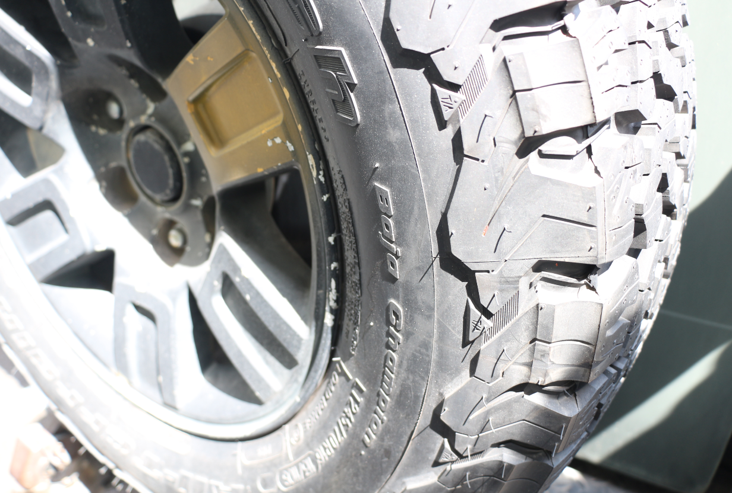
Photographs of MID33853 Damage
Impact Point.
No visible damage sustained.
Debris from the POV tail light.

Slide 8
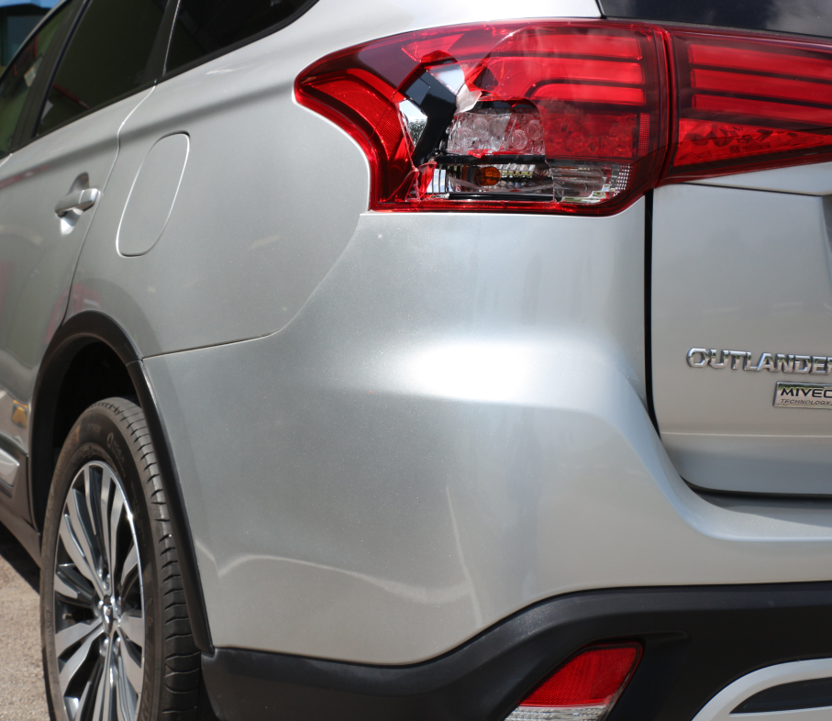
Photographs of POV Damage
LHR Taillight Cracked
LHR Bumper Misaligned

Slide 9
Summary of Incident
Date / Time: 170323 / at about 0940H
Rank / Name: LCP KEITH YAP JUN CHEN, TXXXX205B (TO)
Location of Incident: Parking Lots @ BLK 7A, Chua Chu Kang Camp
Summary of Incident:
On 17 Mar 23 at about 0940hrs, LCP Keith had performed his ground check and proceeded to reverse the vehicle out of the sheltered area at Blk 7A. While reversing, he had accelerated to reverse upslope onto the main road. Responding to Vehicle Commander’s hand signals, he made a right-turn while reversing.
The vehicle reversed onto the main road, which was a downhill slope. When the VC gave the stop signal, LCP Keith did not react in time, causing the spare tyre (contact point) to come in contact with the POV (SKM9535R) parked at the parking lots.
The vehicle had deviated from the intended reversing path, resulting in the OUV to come in contact with the POV.
LCP Keith was licensed and qualified to operate on the military vehicle. He was in satisfactory health condition and had sufficient rest before the task. The task was also authorised.
The OUV was road worthy.

Slide 10
Summary of Incident
Damage assessment:
MID 33853: No damage was observed.
POV: LHR Taillight Cracked, LHR Bumper Misaligned.
No injuries to any personnel.

